Slide 1

DESIGN AND ANALYSIS OF ALGORITHMS (113939)
Dr. Owais Hussain

Slide 2

Agenda
Dijkstra’s Algorithm
Bellman-Ford Algorithm
Kruskal’s Algorithm
Prim’s Algorithm
Floyd-Warshall Algorithm

Slide 3
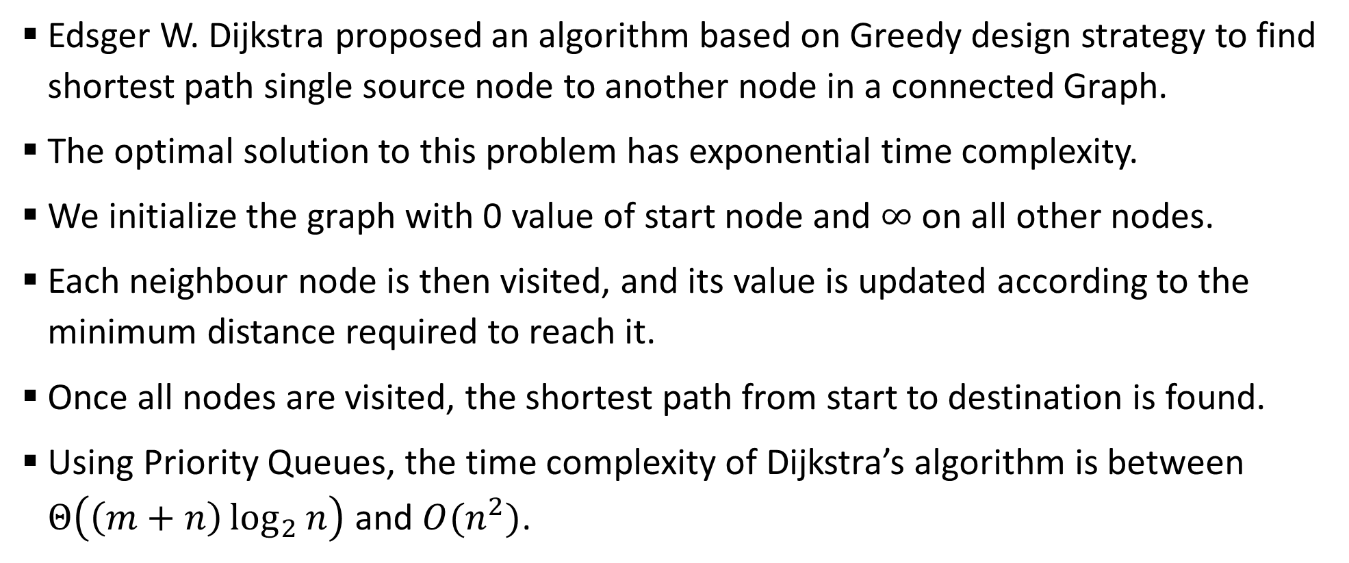
Sample 2
Dijkstra’s Algorithm
Edsger W. Dijkstra proposed an algorithm based on Greedy design strategy to find shortest path single source node to another node in a connected Graph.
The optimal solution to this problem has exponential time complexity.
We initialize the graph with 0 value of start node and $∞$ on all other nodes.
Each neighbour node is then visited, and its value is updated according to the minimum distance required to reach it.
Once all nodes are visited, the shortest path from start to destination is found.
Using Priority Queues, the time complexity of Dijkstra’s algorithm is between $Θ\left(\left(m+n\right)\log_{2}{n}\right)$ and $O(n^{2})$.

Slide 4











Sample 2
Dijkstra’s Algorithm
Once again, you want to reach Tower from Water pump roundabout.
This time, we also have weights on nodes. Water pump’s value is final.
$$∞$$
$$∞$$
$$∞$$
NIPA
18
Bahria Uni
6
Sh-e-Faisal
14
12
6
0
$$∞$$
$$∞$$
$$∞$$
$$∞$$
Water pump
20
3 Hatti
16
Saddar
12
Light house
8
Tower
10
$$∞$$
7
$$∞$$
5
$$∞$$
17
$$∞$$
6
Five Star
Lasbela
Soldier Bazar
Nanakwara
16
10
8

Slide 5
Sample 2
Dijkstra’s Algorithm
Visit all neighbours or Water pump and update their value by adding the minimum time it takes to reach them.
12
$$∞$$
$$∞$$
NIPA
18
Bahria Uni
6
Sh-e-Faisal
14
12
6
0
20
$$∞$$
$$∞$$
$$∞$$
Water pump
20
3 Hatti
16
Saddar
12
Light house
8
Tower
10
10
7
$$∞$$
5
$$∞$$
17
$$∞$$
6
Five Star
Lasbela
Soldier Bazar
Nanakwara
16
10
8

Slide 6
Sample 2
Dijkstra’s Algorithm
Now visit the neighbours of NIPA, 3 Hatti and Five Star.
Watch Lasbela, its value was updated 2nd time when visiting from Five Star.
12
30
$$∞$$
NIPA
18
Bahria Uni
6
Sh-e-Faisal
14
12
6
0
20
36
$$∞$$
$$∞$$
Water pump
20
3 Hatti
16
Saddar
12
Light house
8
Tower
10
10
7
2726
5
$$∞$$
17
$$∞$$
6
Five Star
Lasbela
Soldier Bazar
Nanakwarra
16
10
8

Slide 7
Sample 2
Dijkstra’s Algorithm
Next visits are from Bahria Uni, Saddar and Lasbela.
Sh-e-Faisal only updated once because route from Saddar is expensive.
12
30
36
NIPA
18
Bahria Uni
6
Sh-e-Faisal
14
12
6
0
20
36
48
$$∞$$
Water pump
20
3 Hatti
16
Saddar
12
Light house
8
Tower
10
10
7
2726
5
4136
17
$$∞$$
6
Five Star
Lasbela
Soldier Bazar
Nanakwarra
16
10
8

Slide 8
Sample 2
Dijkstra’s Algorithm
Light house was highlighted with Orange because it was not visited by all of its neighbours. Now it is in Green.
12
30
36
NIPA
18
Bahria Uni
6
Sh-e-Faisal
14
12
6
0
20
36
48
50
Water pump
20
3 Hatti
16
Saddar
12
Light house
8
Tower
10
10
7
2726
5
4136
17
44
6
Five Star
Lasbela
Soldier Bazar
Nanakwarra
16
10
8

Slide 9
Sample 2
Dijkstra’s Algorithm
How do we know we have the shortest path? Let’s fill some tables.
Node | Distance from Start | Path
Water pump | 0 | Water pump
NIPA | 12 | Water pump -> NIPA
3 Hatti | 20 | Water pump -> 3 Hatti
Five Star | 10 | Water pump -> Five Star
Bahria Uni | 30 | Water pump -> NIPA -> Bahria Uni
Saddar | 36 | Water pump -> 3 Hatti -> Saddar
Lasbela | 26 | Water pump -> Five Star -> Lasbela
Sh-e-Faisal | 36 | Water pump -> NIPA -> Bahria Uni -> Sh-e-Faisal
Light house | 48 | Water pump -> 3 Hatti -> Saddar -> Light house
Soldier Bazar | 36 | Water pump -> Five Star -> Lasbela -> Soldier Bazar
Nanakwara | 44 | Water pump -> Five Star -> Lasbela -> Soldier Bazar -> Nanakwara
Tower | 50 | Water pump -> NIPA -> Bahria Uni -> Sh-e-Faisal -> Tower

Slide 10
Sample 2
Dijkstra’s Algorithm
The shortest path from Water Pump to Tower is found to be 50 minute long.
Note that there might be multiple solutions, but Dijsktra’s algorithm finds only one of them.
Secondly, we not only have shortest path from Water pump to Tower, but every node that can be reached from Water pump.
Also note that this algorithm is single source, i.e., the journey can start only from one node.

Slide 11
Sample 2
Bellman-Ford Algorithm – DIY
Bellman-Ford algorithm does exactly what Dijkstra’s algorithm does – finding single source shortest path between a pair of nodes.
It uses Dynamic design strategy but has worse time complexity than Dijsktra’s algorithm.
Unlike Dijsktra’s algorithm, it can also work on graphs with negative weights.
Dijsktra’s algorithm can loop indefinitely if there is a negative cycle in graph. Bellman-Ford algorithm is capable of detecting them.

Slide 12
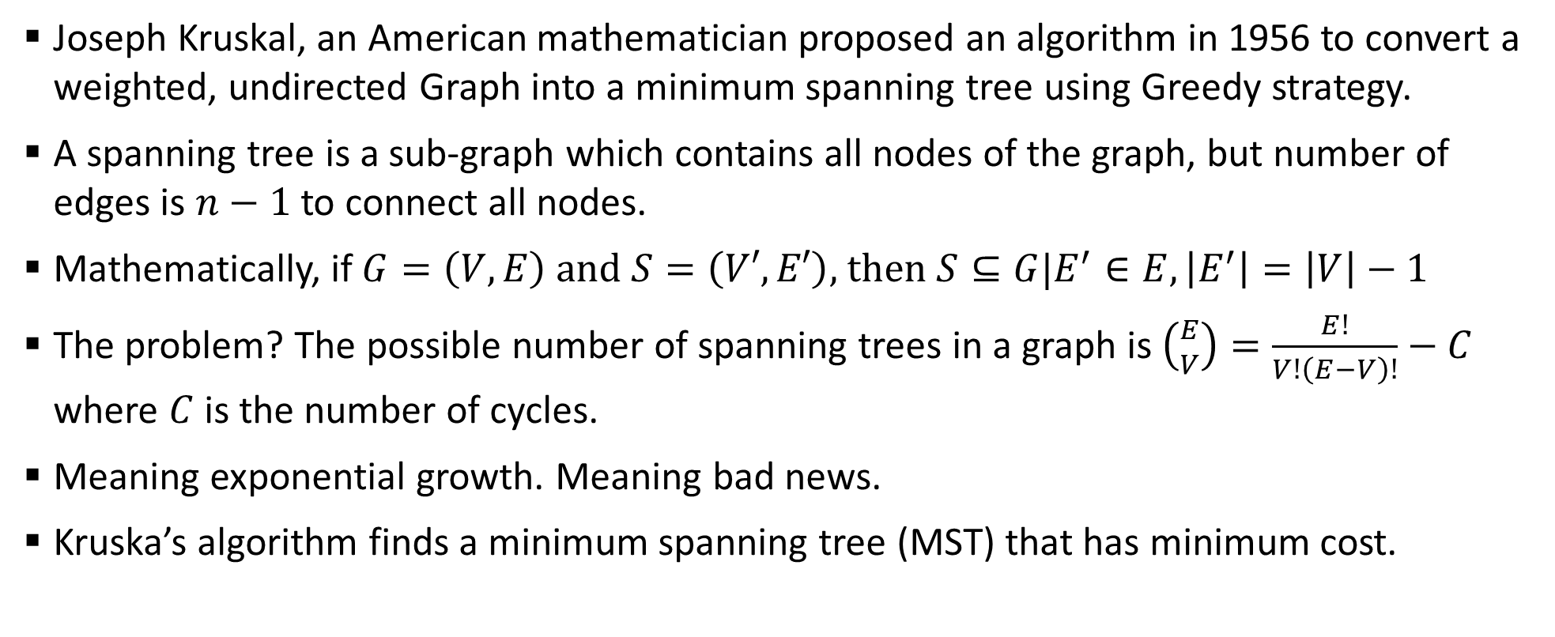
Sample 2
Kruskal’s Algorithm
Joseph Kruskal, an American mathematician proposed an algorithm in 1956 to convert a weighted, undirected Graph into a minimum spanning tree using Greedy strategy.
A spanning tree is a sub-graph which contains all nodes of the graph, but number of edges is $n−1$ to connect all nodes.
Mathematically, if $G=\left(V,E\right)$ and $S=\left(V′,E′\right)$, then $S⊆G|E^{′}∈E,\left|E^{′}\right|=\left|V\right|−1$
The problem? The possible number of spanning trees in a graph is $\left({E \atop V}\right)=\frac{E!}{V!\left(E−V\right)!}−C$ where $C$ is the number of cycles.
Meaning exponential growth. Meaning bad news.
Kruska’s algorithm finds a minimum spanning tree (MST) that has minimum cost.

Slide 13
Sample 2
Kruskal’s Algorithm
Let’s reimagine our example of Karachi. This time, you are walking so each road is two-way for you. You have to find out a path (MST) for a marathon that covers all stops while travelling minimum distance.
NIPA
18
Bahria Uni
6
Sh-e-Faisal
14
12
10
6
Water pump
20
3 Hatti
16
Saddar
12
Light house
8
Tower
10
7
8
5
17
6
Five Star
Lasbela
Soldier Bazar
Nanakwarra
16
10
8

Slide 14
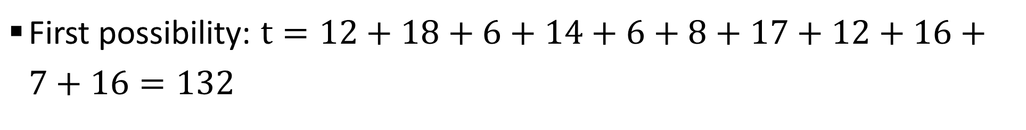
Sample 2
Kruskal’s Algorithm
First possibility: $t=12+18+6+14+6+8+17+12+16+7+16=132$
NIPA
18
Bahria Uni
6
Sh-e-Faisal
14
12
Water pump
3 Hatti
16
Saddar
12
Light house
Tower
7
17
6
Five Star
Lasbela
Soldier Bazar
Nanakwarra
16
8

Slide 15
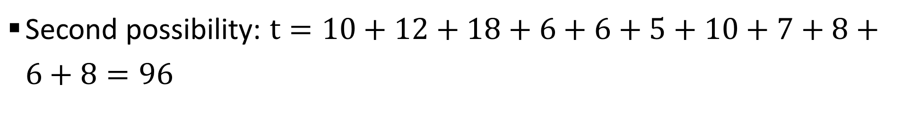
Sample 2
Kruskal’s Algorithm
Second possibility: $t=10+12+18+6+6+5+10+7+8+6+8=96$
NIPA
18
Bahria Uni
6
Sh-e-Faisal
12
6
Water pump
3 Hatti
Saddar
Light house
8
Tower
10
7
5
6
Five Star
Lasbela
Soldier Bazar
Nanakwarra
10
8

Slide 16
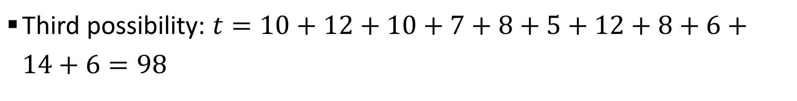
Sample 2
Kruskal’s Algorithm
Third possibility: $t=10+12+10+7+8+5+12+8+6+14+6=98$
NIPA
Bahria Uni
6
Sh-e-Faisal
14
12
10
Water pump
3 Hatti
Saddar
12
Light house
8
Tower
10
7
8
5
6
Five Star
Lasbela
Soldier Bazar
Nanakwarra

Slide 17
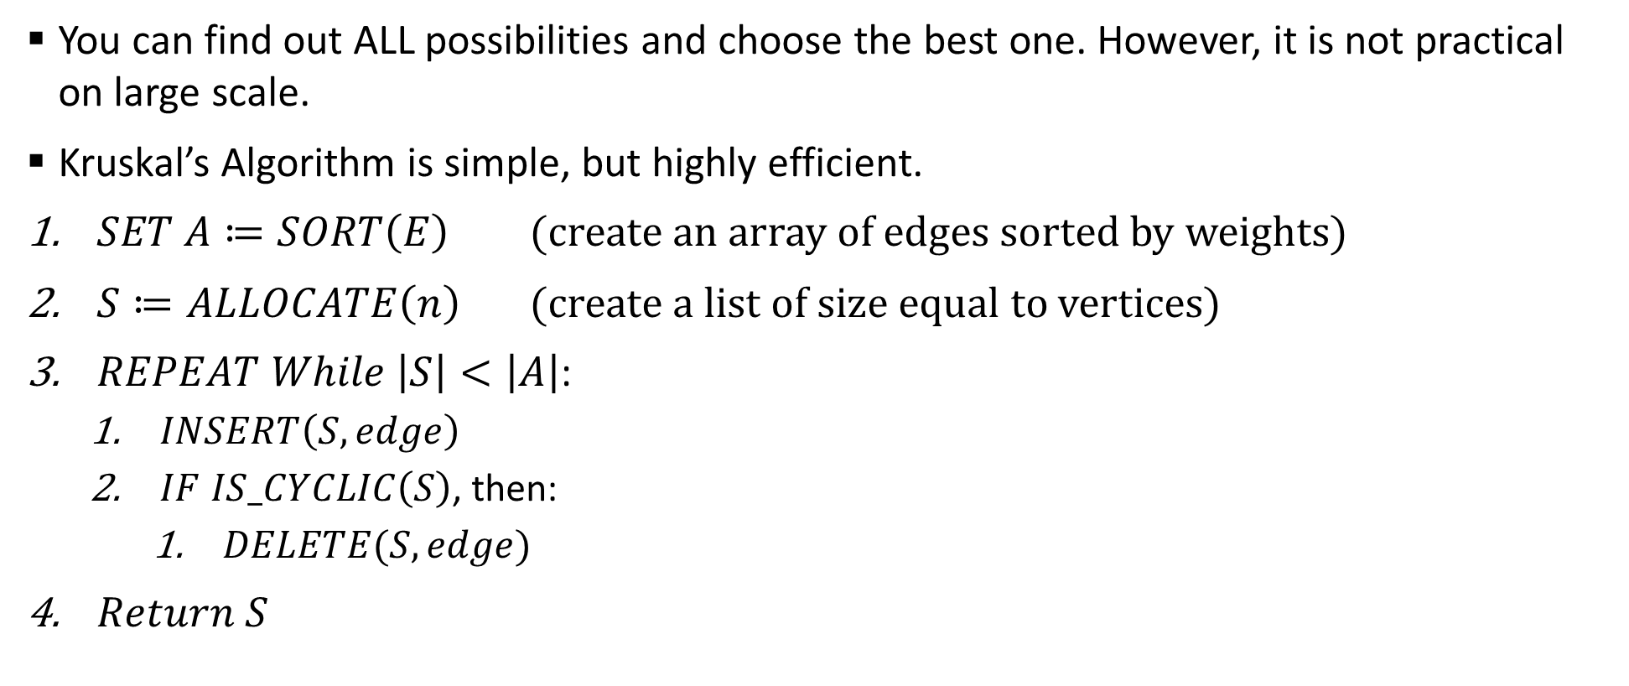
Sample 2
Kruskal’s Algorithm
You can find out ALL possibilities and choose the best one. However, it is not practical on large scale.
Kruskal’s Algorithm is simple, but highly efficient.
$SET A≔SORT\left(E\right)$ (create an array of edges sorted by weights)
$S≔ALLOCATE\left(n\right)$ (create a list of size equal to vertices)
$REPEAT While \left|S\right|<\left|A\right|$:
$INSERT\left(S,edge\right)$
$IF IS_CYCLIC\left(S\right)$, then:
$DELETE(S,edge)$
$Return S$

Slide 18
Sample 2
Kruskal’s Algorithm
Let’s now find MST using Kruskal’s algorithm. The array of sorted edges will be:
node1 | node2 | time | node1 | node2 | time
Saddar | Soldier Bazar | 5 | Lasbela | Soldier Bazar | 10
Bahria Uni | Sh-e-Faisal | 6 | Water pump | NIPA | 12
Saddar | Sh-e-Faisal | 6 | Saddar | Light house | 12
Nanakwara | Tower | 6 | Sh-e-Faisal | Tower | 14
3 Hatti | Lasbela | 7 | 3 Hatti | Saddar | 16
Saddar | Lasbela | 8 | Five Star | Lasbela | 16
Light hosue | Tower | 8 | Soldier Bazar | Light house | 17
Soldier Bazar | Nanakwara | 8 | NIPA | Bahria Uni | 18
Water pump | Five Star | 10 | Water pump | 3 Hatti | 20
NIPA | 3 Hatti | 10

Slide 19
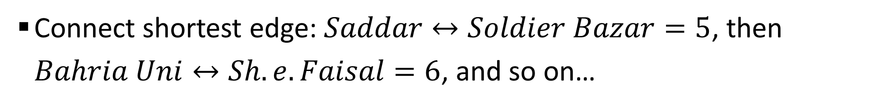
Sample 2
Kruskal’s Algorithm
Connect shortest edge: $Saddar↔Soldier Bazar=5$, then $Bahria Uni↔Sh.e.Faisal=6$, and so on…
NIPA
Bahria Uni
6
Sh-e-Faisal
12
10
6
Water pump
3 Hatti
Saddar
Light house
8
Tower
7
8
5
10
6
Five Star
Lasbela
Soldier Bazar
8
Nanakwara

Slide 20
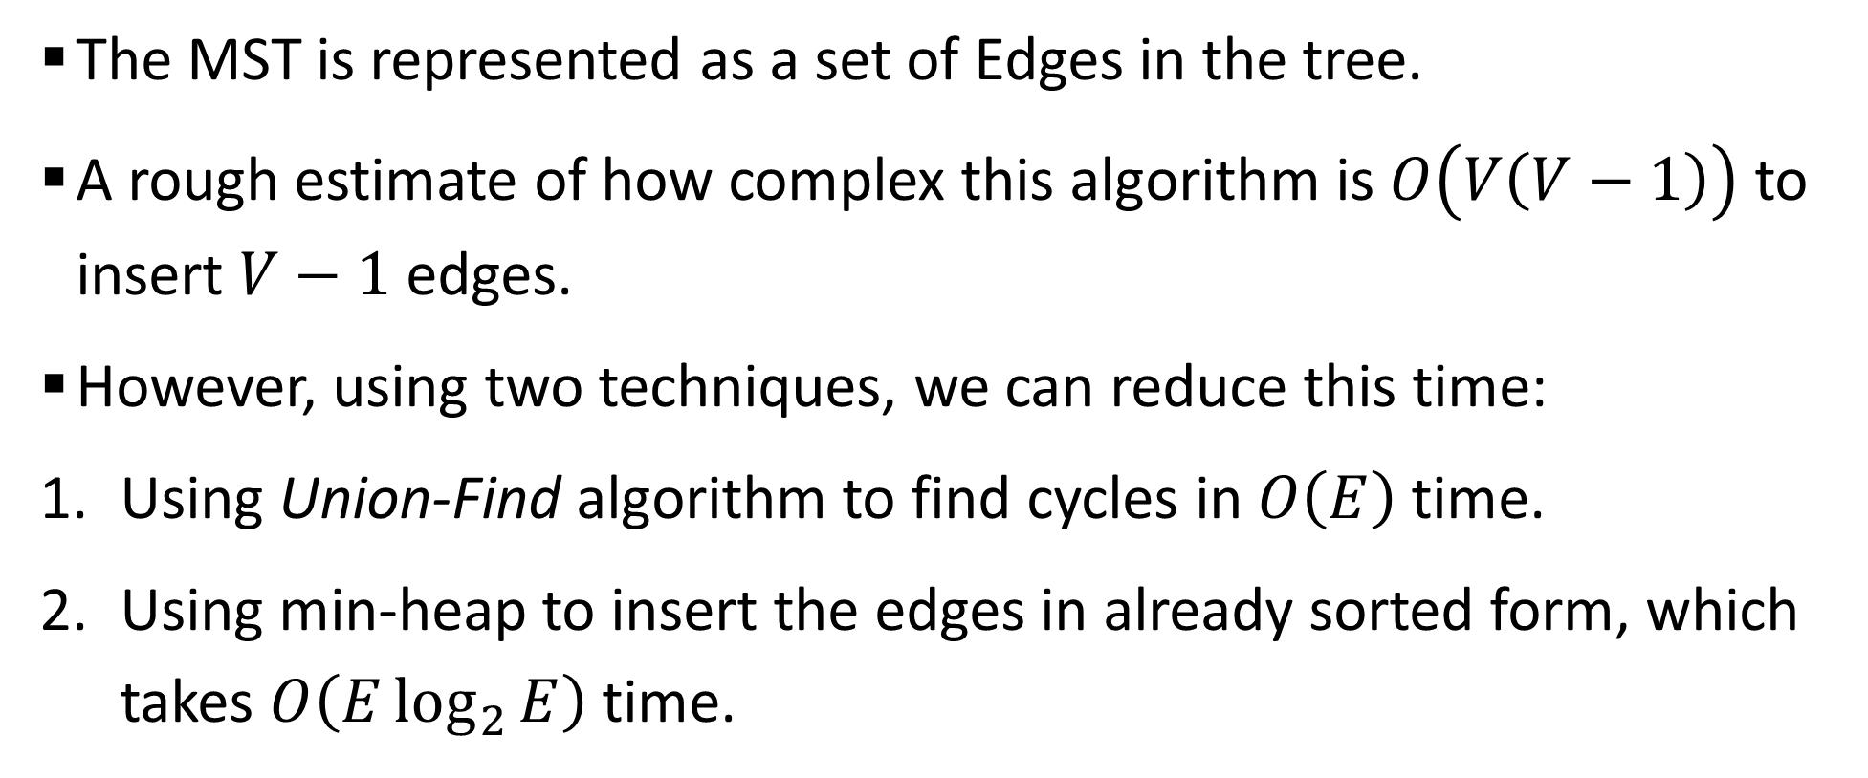
Sample 2
Kruskal’s Algorithm
The MST is represented as a set of Edges in the tree.
A rough estimate of how complex this algorithm is $O\left(V\left(V−1\right)\right)$ to insert $V−1$ edges.
However, using two techniques, we can reduce this time:
Using Union-Find algorithm to find cycles in $O\left(E\right)$ time.
Using min-heap to insert the edges in already sorted form, which takes $O\left(E\log_{2}{E}\right)$ time.
Notes:
Union-find is also known as disjoint set. Two sets are disjoint if they don’t have any element in common.

Slide 21
Sample 2
Kruskal’s Algorithm
Therefore, the Kruskal’s algorithm can execute in logarithmic time even in worst case scenario (i.e., when only the costliest edges are cycle-free).
One of the accidental benefits of Kruskal’s algorithm is that even if a graph is not connected, it will still find MST for all the disconnected subgraphs.

Slide 22
Sample 2
Prim’s Algorithm
Prim’s algorithm uses Greedy approach, but in many ways it is worse than Kruskal’s algorithm.
DIY: solve the same example we solved for Kruskal’s algorithm using Prim’s algorithm.
DIY: find out any single benefit of Prim’s algorithm over Kruskal’s algorithm.

Slide 23
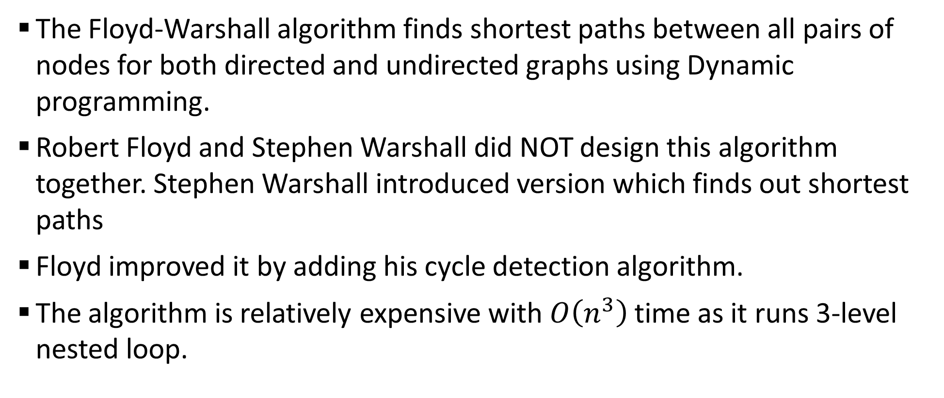
Sample 2
Floyd-Warshall Algorithm
The Floyd-Warshall algorithm finds shortest paths between all pairs of nodes for both directed and undirected graphs using Dynamic programming.
Robert Floyd and Stephen Warshall did NOT design this algorithm together. Stephen Warshall introduced version which finds out shortest paths
Floyd improved it by adding his cycle detection algorithm.
The algorithm is relatively expensive with $O\left(n^{3}\right)$ time as it runs 3-level nested loop.

Slide 24
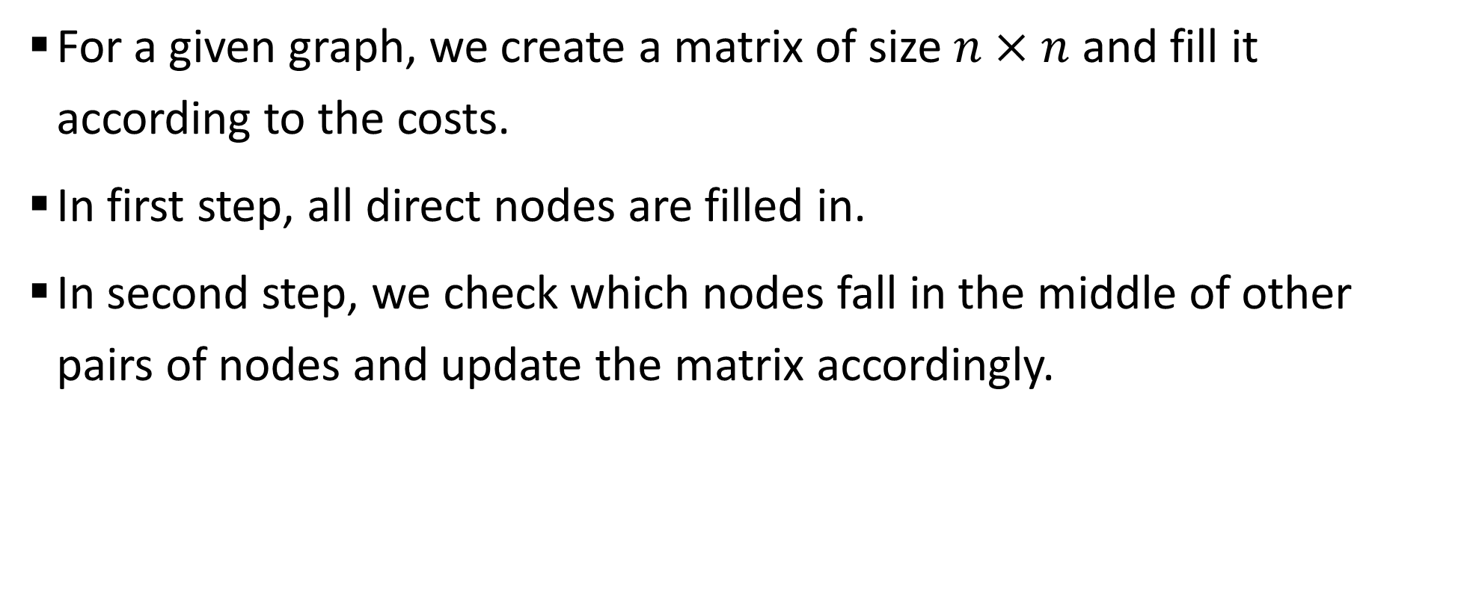
Sample 2
Floyd-Warshall Algorithm
For a given graph, we create a matrix of size $n×n$ and fill it according to the costs.
In first step, all direct nodes are filled in.
In second step, we check which nodes fall in the middle of other pairs of nodes and update the matrix accordingly.

Slide 25
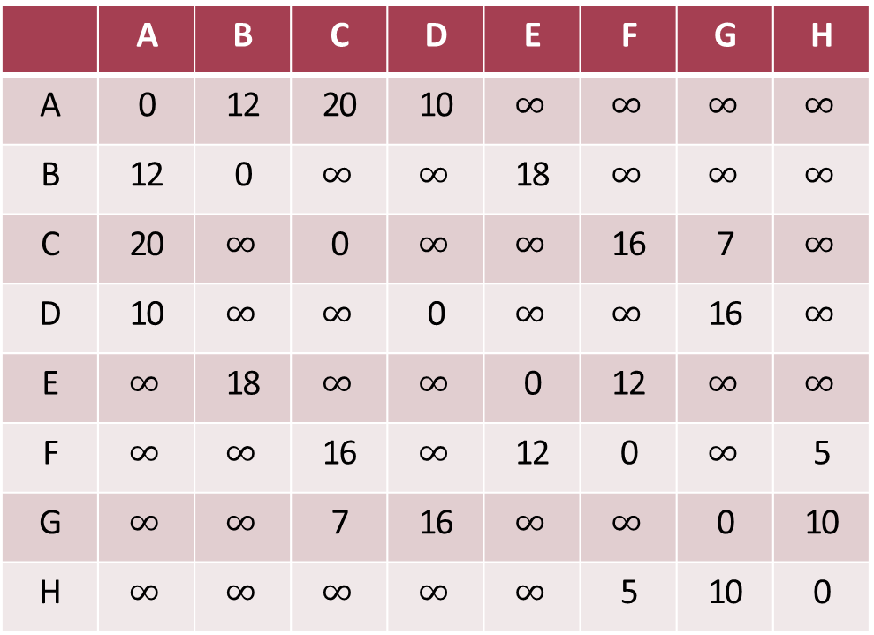
Sample 2
Floyd-Warshall Algorithm
For a given graph, we create a matrix of size $n×n$ and fill it according to the costs.
 | A | B | C | D | E | F | G | H
A | 0 | 12 | 20 | 10 | $$∞$$ | $$∞$$ | $$∞$$ | $$∞$$
B | 12 | 0 | $$∞$$ | $$∞$$ | 18 | $$∞$$ | $$∞$$ | $$∞$$
C | 20 | $$∞$$ | 0 | $$∞$$ | $$∞$$ | 16 | 7 | $$∞$$
D | 10 | $$∞$$ | $$∞$$ | 0 | $$∞$$ | $$∞$$ | 16 | $$∞$$
E | $$∞$$ | 18 | $$∞$$ | $$∞$$ | 0 | 12 | $$∞$$ | $$∞$$
F | $$∞$$ | $$∞$$ | 16 | $$∞$$ | 12 | 0 | $$∞$$ | 5
G | $$∞$$ | $$∞$$ | 7 | 16 | $$∞$$ | $$∞$$ | 0 | 10
H | $$∞$$ | $$∞$$ | $$∞$$ | $$∞$$ | $$∞$$ | 5 | 10 | 0
B
18
E
12
12
A
20
C
16
F
10
7
5
D
G
H
16
10

Slide 26
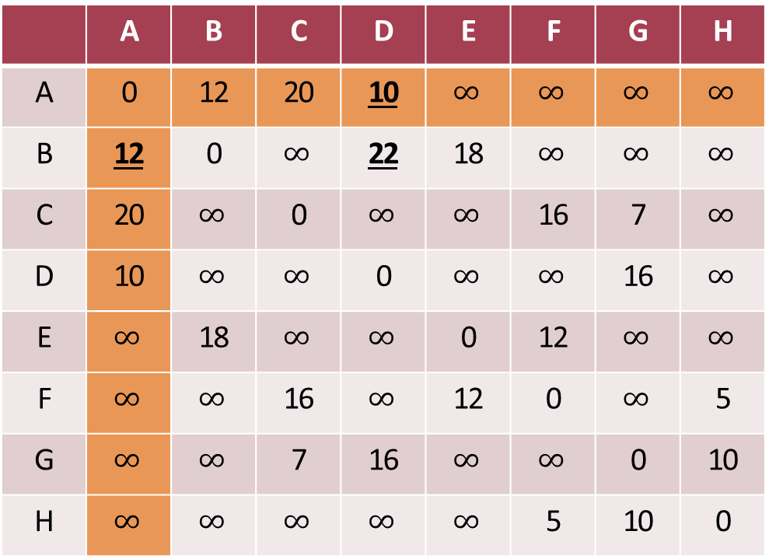
Sample 2
Floyd-Warshall Algorithm
Now let’s pick ‘A’ as middle node and see which two nodes it connects.
 | A | B | C | D | E | F | G | H
A | 0 | 12 | 20 | 10 | $$∞$$ | $$∞$$ | $$∞$$ | $$∞$$
B | 12 | 0 | $$∞$$ | 22 | 18 | $$∞$$ | $$∞$$ | $$∞$$
C | 20 | $$∞$$ | 0 | $$∞$$ | $$∞$$ | 16 | 7 | $$∞$$
D | 10 | $$∞$$ | $$∞$$ | 0 | $$∞$$ | $$∞$$ | 16 | $$∞$$
E | $$∞$$ | 18 | $$∞$$ | $$∞$$ | 0 | 12 | $$∞$$ | $$∞$$
F | $$∞$$ | $$∞$$ | 16 | $$∞$$ | 12 | 0 | $$∞$$ | 5
G | $$∞$$ | $$∞$$ | 7 | 16 | $$∞$$ | $$∞$$ | 0 | 10
H | $$∞$$ | $$∞$$ | $$∞$$ | $$∞$$ | $$∞$$ | 5 | 10 | 0
B
18
E
12
12
A
20
C
16
F
10
7
5
D
G
H
16
10

Slide 27
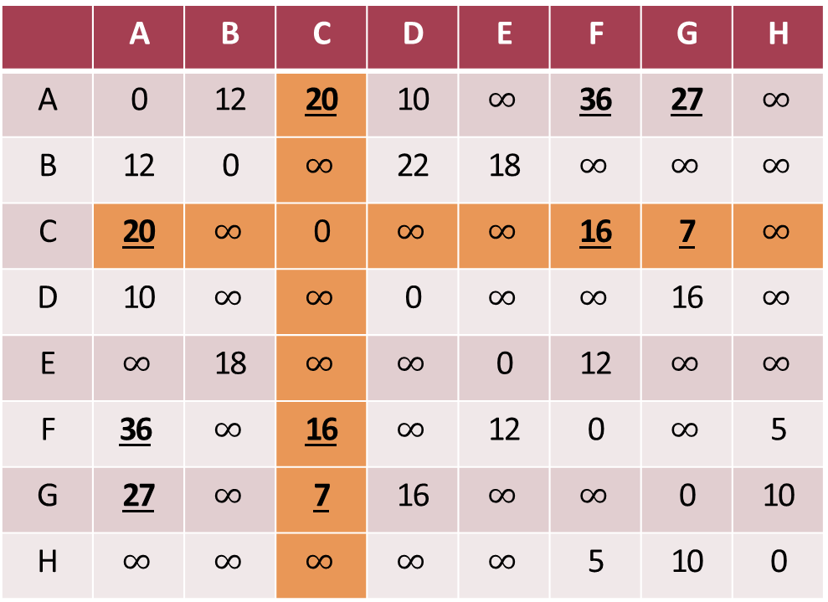
Sample 2
Floyd-Warshall Algorithm
Let’s do another iteration for ‘C’ as middle node.
 | A | B | C | D | E | F | G | H
A | 0 | 12 | 20 | 10 | $$∞$$ | 36 | 27 | $$∞$$
B | 12 | 0 | $$∞$$ | 22 | 18 | $$∞$$ | $$∞$$ | $$∞$$
C | 20 | $$∞$$ | 0 | $$∞$$ | $$∞$$ | 16 | 7 | $$∞$$
D | 10 | $$∞$$ | $$∞$$ | 0 | $$∞$$ | $$∞$$ | 16 | $$∞$$
E | $$∞$$ | 18 | $$∞$$ | $$∞$$ | 0 | 12 | $$∞$$ | $$∞$$
F | $$\text{36}$$ | $$∞$$ | 16 | $$∞$$ | 12 | 0 | $$∞$$ | 5
G | 27 | $$∞$$ | 7 | 16 | $$∞$$ | $$∞$$ | 0 | 10
H | $$∞$$ | $$∞$$ | $$∞$$ | $$∞$$ | $$∞$$ | 5 | 10 | 0
B
18
E
12
12
A
20
C
16
F
10
7
5
D
G
H
16
10

Slide 28
Sample 2
Floyd-Warshall Algorithm
Similarly, we repeat the process for all nodes to get final table
 | A | B | C | D | E | F | G | H
A | 0 | 12 | 20 | 10 | 30 | 36 | 26 | 36
B | 12 | 0 | 32 | 22 | 18 | 30 | 38 | 3
C | 20 | 32 | 0 | 23 | 28 | 16 | 7 | 17
D | 10 | 22 | 23 | 0 | 40 | 31 | 16 | 26
E | 30 | 18 | 28 | 40 | 0 | 12 | 27 | 17
F | 36 | 30 | 16 | 30 | 12 | 0 | 15 | 5
G | 26 | 38 | 7 | 16 | 27 | 15 | 0 | 10
H | 36 | 3 | 17 | 26 | 17 | 5 | 10 | 0
B
18
E
12
12
A
20
C
16
F
10
7
5
D
G
H
16
10

Slide 29
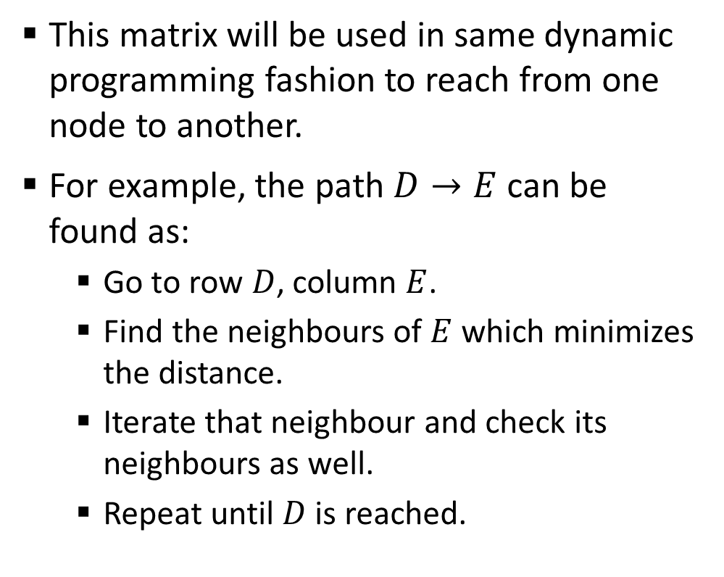
Sample 2
Floyd-Warshall Algorithm
This matrix will be used in same dynamic programming fashion to reach from one node to another.
For example, the path $D→E$ can be found as:
Go to row $D$, column $E$.
Find the neighbours of $E$ which minimizes the distance.
Iterate that neighbour and check its neighbours as well.
Repeat until $D$ is reached.
 | A | B | C | D | E | F | G | H
A | 0 | 12 | 20 | 10 | 30 | 36 | 26 | 36
B | 12 | 0 | 32 | 22 | 18 | 30 | 38 | 3
C | 20 | 32 | 0 | 23 | 28 | 16 | 7 | 17
D | 10 | 22 | 23 | 0 | 40 | 31 | 16 | 26
E | 30 | 18 | 28 | 40 | 0 | 12 | 27 | 17
F | 36 | 30 | 16 | 30 | 12 | 0 | 15 | 5
G | 26 | 38 | 7 | 16 | 27 | 15 | 0 | 10
H | 36 | 3 | 17 | 26 | 17 | 5 | 10 | 0

Slide 30



THANK YOU
Owais Hussain
+92 345-3174270
owais.hussain@kiet.edu.pk
https://www.researchgate.net/profile/Owais-Hussain-3

